Slide 1
Salesforce Pen Testing Tips & Tricks
Rodney Beede
May 2024

Slide 2
About Me
Principal consultant
Cloud security testing > 10 years
Multiple CVEs discovered
Started as J2EE software developer
M.S. in C.S. - "A Framework for Benevolent Computer Worms" 2012
Coalfire, Rackspace, Seagate, HP, Cisco, RiskMetrics (MSCI)
Presenter at: BSides, InnoTech, Black Hat
https://www.rodneybeede.com/curriculum%20vitae/bio.html

Slide 3
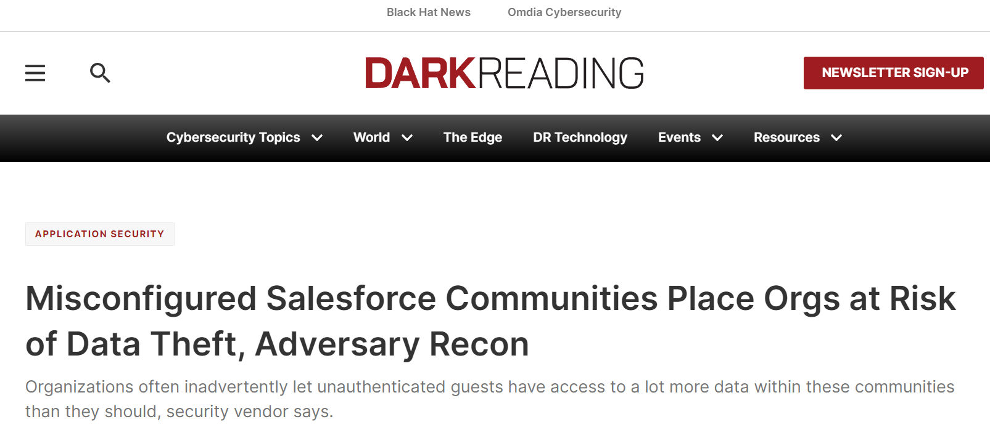
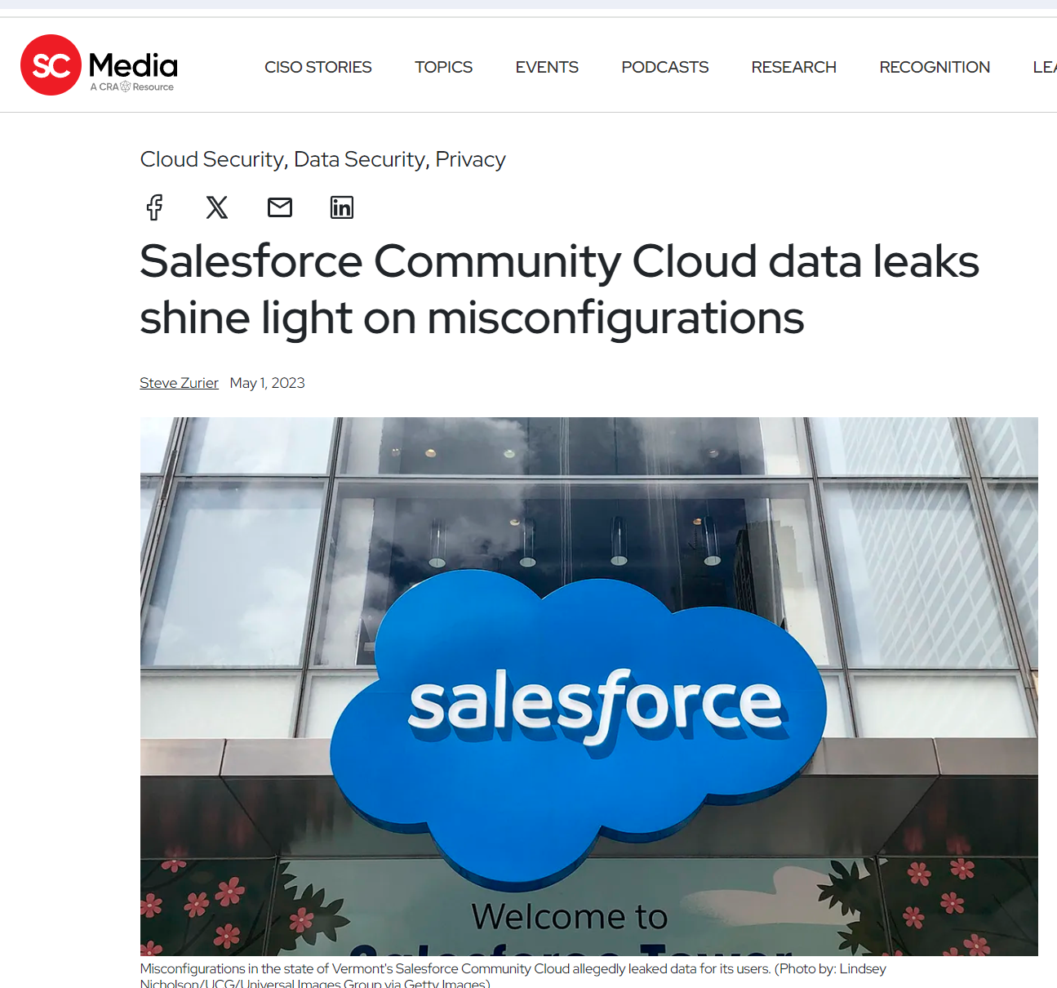
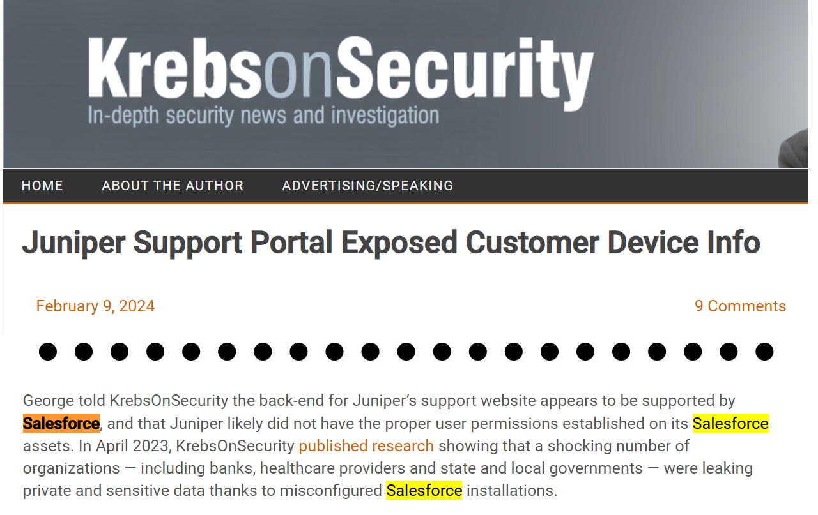
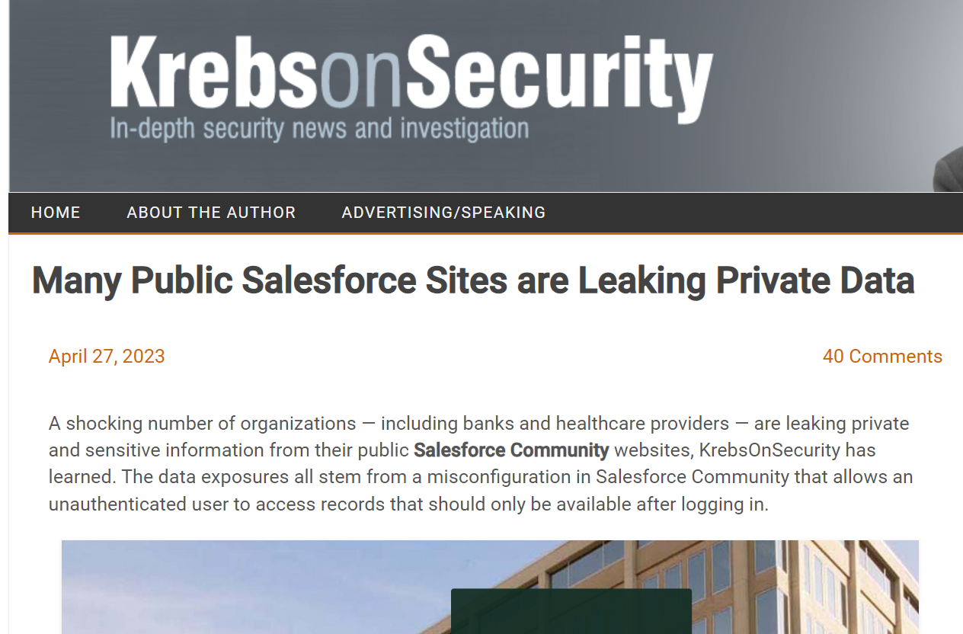
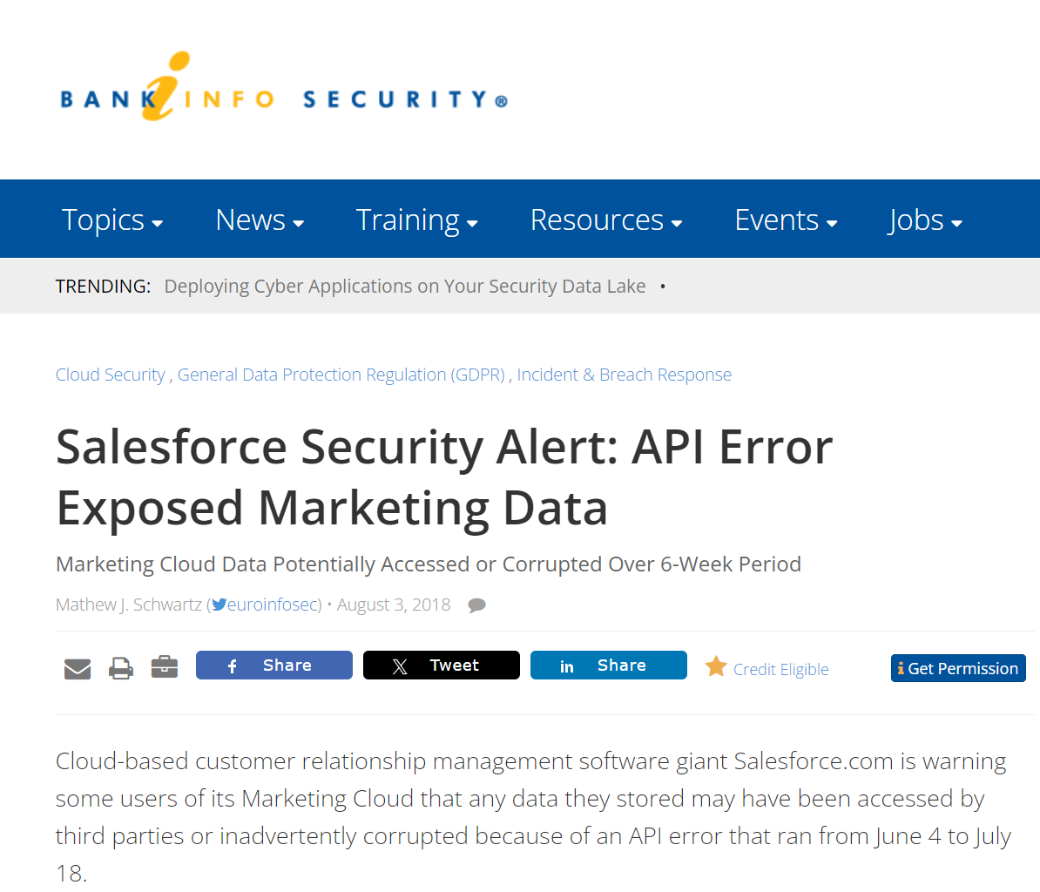
Why Test Salesforce Apps?
https://krebsonsecurity.com/2024/02/juniper-support-portal-exposed-customer-device-info/
https://www.scmagazine.com/news/salesforce-community-cloud-data-leaks-misconfigurations
https://krebsonsecurity.com/2023/04/many-public-salesforce-sites-are-leaking-private-data/
https://www.bankinfosecurity.com/salesforce-security-alert-api-error-exposed-marketing-data-a-11278
https://www.darkreading.com/application-security/misconfigured-salesforce-communities-place-orgs-at-risk-of-data-theft-adversary-recon

Slide 4
What Not to Test
Know the Salesforce policy -https://www.salesforce.com/company/disclosure/
Spam, Brute Force, Denial of Service
Accessing other customers' data
Attacking Salesforce employees (social engr, etc)
Tests against prod accounts
See salesforce.com Vulnerability Reporting Policy

Slide 5
Big List of Useful Reference Material
Security Tips for Apex and Visualforce Development
https://developer.salesforce.com/docs/atlas.en-us.apexcode.meta/apexcode/pages_security_tips_intro.htm
Using the with sharing, without sharing, and inherited sharing Keywords
https://developer.salesforce.com/docs/atlas.en-us.apexcode.meta/apexcode/apex_classes_keywords_sharing.htm
Considerations for Sharing and Accessing Contacts
https://help.salesforce.com/s/articleView?id=sf.contacts_sharing_considerations.htm&type=5
Cross Site Scripting (XSS)
https://developer.salesforce.com/docs/atlas.en-us.apexcode.meta/apexcode/pages_security_tips_xss.htm
SOQL SELECT Syntax
https://developer.salesforce.com/docs/atlas.en-us.soql_sosl.meta/soql_sosl/sforce_api_calls_soql_select.htm
Open Redirects
https://developer.salesforce.com/docs/atlas.en-us.packagingGuide.meta/packagingGuide/secure_code_violation_open_redirects.htm
Best Practices for Static Resources
https://developer.salesforce.com/docs/atlas.en-us.pages.meta/pages/pages_compref_additional_page.htm
Salesforce Object Search Language (SOSL)
https://developer.salesforce.com/docs/atlas.en-us.soql_sosl.meta/soql_sosl/sforce_api_calls_sosl.htm
Dynamic SOSL
https://developer.salesforce.com/docs/atlas.en-us.apexcode.meta/apexcode/apex_dynamic_sosl.htm
Regular Expression to Escape SOQL/SOSL Inputs
https://anothersalesforceblog.com/2021/07/01/regular-expression-soql-sosl/
Slightly SOSL'ed: Locating And Testing SOSL Injection - Nick Dunn
https://www.youtube.com/watch?v=VYCy1VXmklw
CSRF Protection Settings
https://help.salesforce.com/s/articleView?id=000387060&type=1&isdtp=p1
Mitigate Cross-Site Request Forgery
https://trailhead.salesforce.com/content/learn/modules/secure-serverside-development/mitigate-crosssite-request-forgery?trail_id=security_developer&isdtp=p1
Cross-Site Request Forgery (CSRF)
https://developer.salesforce.com/docs/atlas.en-us.pages.meta/pages/pages_security_tips_csrf.htm?isdtp=p1
Encrypted Field Security Issue - salesforce.stackexchange.com
Encrypted Field is Masked in a Visualforce Page When Embedded into a Standard Layout
The Top 20 Vulnerabilities Found in the AppExchange Security Review
https://security.salesforce.com/security-advisories

Slide 6
Source Code Review
Grep strings (search case-insensitive)
apex:outputText
grep -i escape
Look for escape=false
Inside an apex <script> or other section
{!something input here}
{!CurrentPage.parameters}

Slide 7
Example code:
Value of myTextField is <apex:outputText value="{!myTextField}" escape="false"/>
Observe that the <apex> tag can be broken over multiple lines
Plan your grep regex accordingly

Slide 8
Cross-Site Request Forgery (CSRF)
apex:page
| grep -i ' action='
Using the action method can bypass built-in security controls
https://developer.salesforce.com/docs/atlas.en-us.apexcode.meta/apexcode/pages_security_tips_csrf.htm

Slide 9
Example CSRF Vuln
<apex:page controller="myClass" action="{!init}"</apex:page>
public class myClass {
public void init() {
Id id = ApexPages.currentPage().getParameters().get('id');
Account obj = [select id, Name FROM Account WHERE id = :id];
delete obj;
return ;
}
}

Slide 10
XML Usage
grep -i xml
Looking for third-party library parsers.
File uploads with xxe.xml

Slide 11
Deserialization
grep -Ri serial | grep -v json | grep -v .js
Platform has roots in Java, but rare to see binary deserialization used unless importing external source data

Slide 12
CRUD/FLS (“System Context”)
grep -Ri getParameter[s]?
grep –Ri ApexPages.currentPage
grep –Ri System.currentPageReference
grep –Ri ‘[$]CurrentPage’
Access permissions are not enforced when code is in the System Context

Slide 13
without sharing
grep –Ri ‘without sharing’
Default for Apex classes
Thus, not common to see these words
“with sharing” enforces security context scope
So, ensure every Apex .cls uses “with sharing”

Slide 14
SOSL
Looking for indexed data to steal
grep –RiP “FIND\s+”
Query string with unsafe string concatenation in code
“FIND ‘“ + userQuery + “*' IN ALL FIELDS RETURNING APEX_Invoice__c
(Id,APEX_Customer__r.Name)

Slide 15
SOQL (Salesforce Object Query Lang.)
No UNION/JOIN features – so reduced attack surface
If you use the binding vars
Inputs typically not vulnerable
But sometimes folks ignore even simple best practice
Common vulns (real-life injections)
ORDER BY untrusted-user-input-for-field-here
Try “someLegitField” + “DESC” (not the default sort order)
FROM untrusted-user-input-for-table-here
Developer tried to use 1 query for multiple tables
In the table part instead of in the WHERE part
https://developer.salesforce.com/docs/atlas.en-us.soql_sosl.meta/soql_sosl/sforce_api_calls_soql_select.htm

Slide 16
SOQL Example
SELECT Id, Name FROM APEX_Customer__c
WHERE Name = :CustomerName
ORDER BY Name
➔➔➔
“SELECT FIELDS(ALL) FROM ” + qTable +
“ WHERE Name = :CustomerName “ +
“ ORDER BY “ + paramSortBy

Slide 17
SOQL Example - Params
You can set CustomerName, but it is always escaped
qTable could be static enums in code somewhere or it could be untrusted user input
paramSortBy = “Name DESC” hints at attack vector
“SELECT FIELDS(ALL) FROM ” + qTable +
“ WHERE Name = :CustomerName “ +
“ ORDER BY “ + paramSortBy

Slide 18
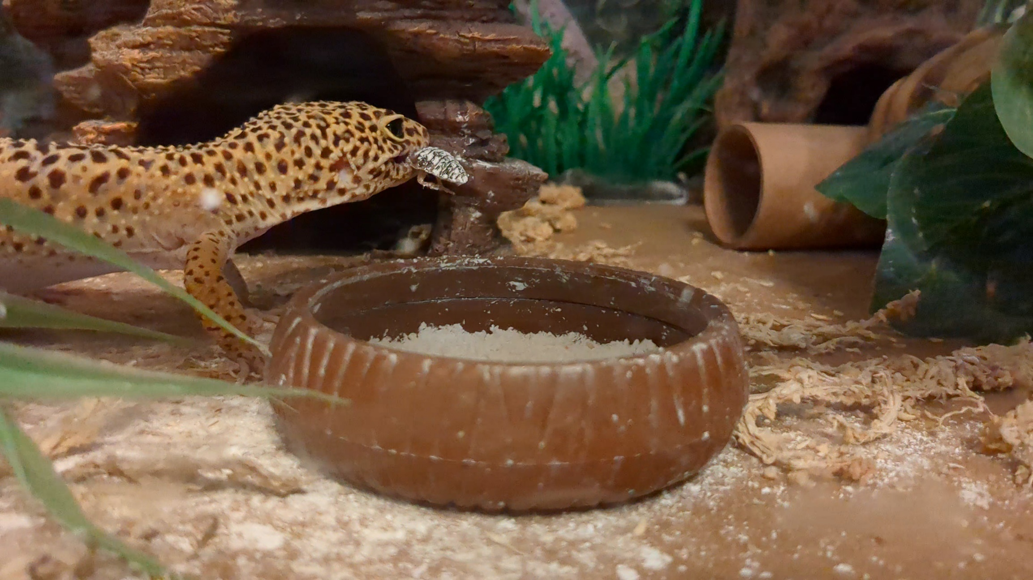
Dynamic Testing

Slide 19
Unlinked "Hidden" Pages
GET /apex/SomeFunctionHere?id=a0a0x00001abcd
Guess the name

Slide 20
Type Checking
Salesforce has lots of validation
?id=a0a0x00001abcd versus
?id=%3C%73%63%72%69%70%74%3E%61%6C%65%72%74%28%31%32%33%29%3C%2F%73%63%72%69%70%74%3E
Errors occur not due to characters but because attempt to cast object failed in an unexpected type

Slide 21
Type Checking - Attacks
For common params like ?id= try
Providing a valid ID belonging to a different class type
Ex: Contact when an Opportunity was expected
Likely to lead to an error, but sometimes not

Slide 22
Third-Party Libraries
Have found XSS from vulnerable libraries
Not from CDN links
Local code deployments for a specific Salesforce app
Placed into /static/ or /resource/ or similar folder names
Once saw a Flash swf vulnerability
Was not needed by the app but included in the 3rd party JavaScript library
Allowed for a working XSS exploit

